Slide 1
Assignment #3
Yearly Solicitation Plan
Team 17
BABU Greshma
CHUGH Aashima
JAIN Vidhi Mahavir
PALMA Chiara
YOPA Paul-Henry

Slide 2
Roadmap
SEGMENTATION
Combining 1 and 2
RECOMMENDATIONS
How to use the tools developed
MODEL 1
Donors reaction campaigns
05
06
02
04
07
03
CHURN MODEL
Prevent donors from leaving
01
PROBLEM DEFINITION
Analysis of past campaigns
MODEL 2
Analysis of donors Life Time Value
BUDGET PLANNING

Slide 3

Analysis of past campaigns

Slide 4
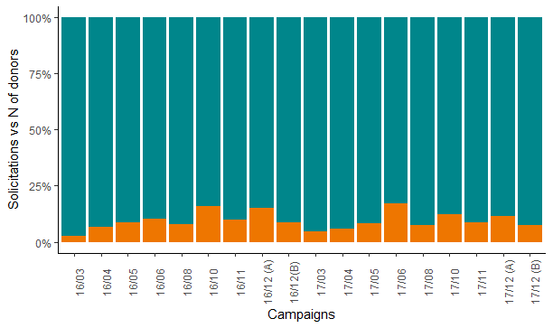
Reach of past campaigns
The graph shows in percentage how many donors donated after having been solicited during the past campaigns.
Past campaigns were in general not efficient, with a maximum percentage of donations being less than 25%
Most efficient campaigns in 2016 were in October and in the first part of December, while in 2017 were in June and in October

Slide 5
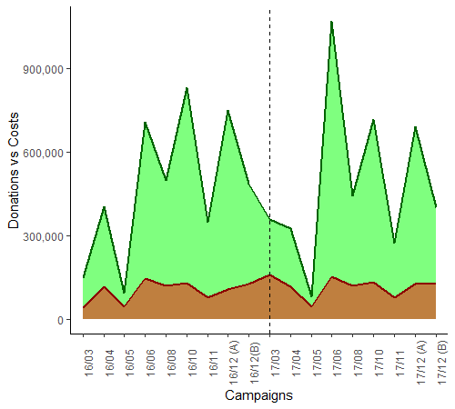
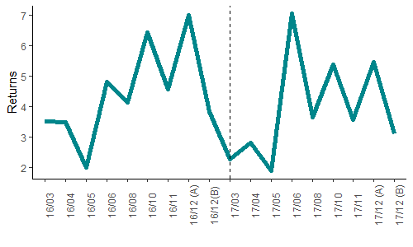
Revenues and cost of past campaigns
Returns from past campaigns were always positive
Cost stays almost constant during the year except from May in which in general less money is spend
Revenues show more seasonality, with peaks generally in June, October and in the first part of December, and with the worst performance in May

Slide 6

Donors’ reaction to campaigns
Short term view

Slide 7
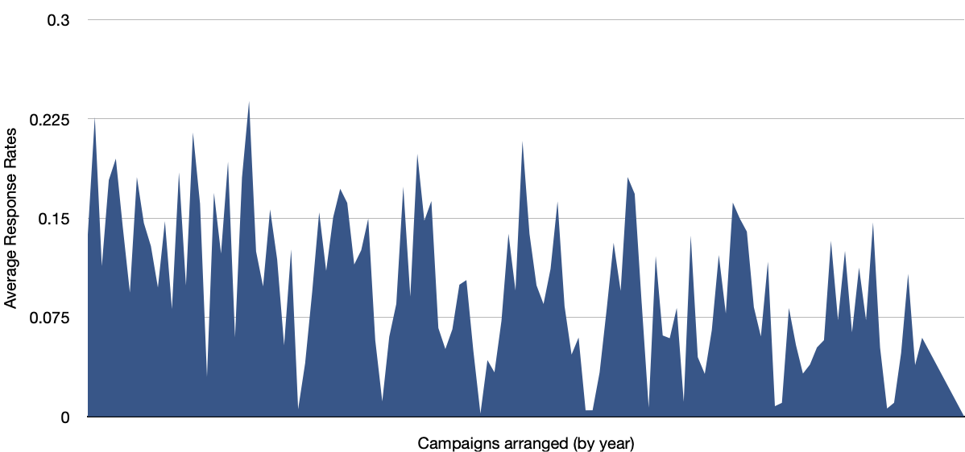
Why model our campaigns?
Avg response rate of campaigns ~ 10%
TAKEAWAY:
WE SPEND LARGE AMOUNT OF MONEY SOLICITING PEOPLE WHO DO NOT RESPOND!!!

Slide 8
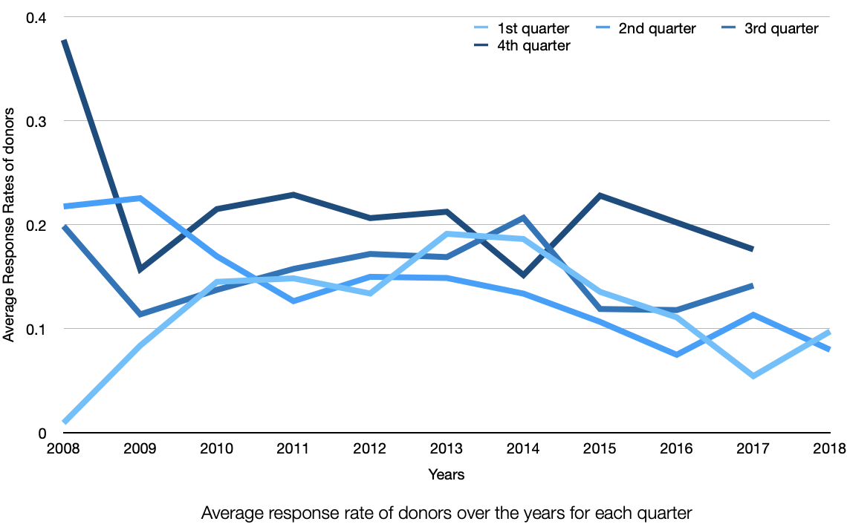
Why model our campaigns?
Quarters | Response Rate
Q1 | 11.78%
Q2 | 14.06%
Q3 | 15.33%
Q4 | 21.56%
KEY TAKEAWAYS
Campaign average response rate ~ 10%
We are spending a large amount of money soliciting people who do not respond
Campaign performance is not consistent across the year: campaigns held in the 4th quarter perform better

Slide 9
Who to solicit? - Short-term view
https://docs.google.com/presentation/d/1yBQBr-EOSBplSwiuBftqiju5v6ODRQ9Q/edit?usp=sharing&ouid=110897629647135927868&rtpof=true&sd=true
PLAN OF ACTION: 9 major fundraising campaigns
WHAT WE NEED TO KNOW:
WHO to solicit
WHEN to solicit to maximise campaign efficiency
WHAT WE KNOW:
Campaigns similar to each campaign we are launching
How people reacted in general to campaigns
Donor’s behavioural metrics (recency, frequency, loyalty, avg donation amount, max donation amount…)
Modelling using these known
factors as predictors

Slide 10
Modelling approach
RESPONSE PROBABILITY
Predict the donor probability to respond to the campaign
DONATION AMOUNT
Predict the donation amount the donor will make
EXPECTED DONATION AMOUNT
Combine both models to compute the expected donation amount for each donor
Fit one model for each major fundraising campaign in order to better capture each campaign specifics

Slide 11
Model implications
What all we can therefore estimate:
Whom to solicit
When to solicit each person (ie, which campaign(s) to use among all campaigns)
How many campaigns to target to each person?
Budget for each campaign (since we know whom all to solicit)
Estimated revenue from each campaign
Estimated profits from each campaign

Slide 12
Results from the model
Month | Average solicitations made/to be made |  | Average no of donors |  | Average amount obtained/estimated |  | Profit
 | Avg in similar campaigns of 2016/17 | Estimated for 2019 | Avg in similar campaigns of 2016/17 | Estimated for 2019 | Avg in similar campaigns of 2016/17 | Estimated for 2019 | Avg in similar campaigns of 2016/17 | Estimated for 2019
March | 89K | 84K | 4K | 84K | 252K | 204K | 224K | 108K
April | 107K | 80K | 7K | 80K | 364K | 383K | 333K | 290K
May | 23K | 87K | 2K | 87K | 86K | 874K | 60K | 775K
June | 146K | 87K | 20K | 87K | 887K | 712K | 845K | 613K
August | 113K | 87K | 9K | 87K | 470K | 523K | 437K | 424K
October | 125K | 86K | 18K | 86K | 773K | 800K | 733K | 701K
November | 60K | 86K | 6K | 86K | 311K | 584K | 281K | 486K
December (A) | 108K | 87K | 14K | 87K | 720K | 854K | 683K | 755K
December (B) | 121K | 87K | 10K | 87K | 442K | 478K | 409K | 379K
TOTAL |  |  |  |  |  |  | 400.4K | 453.1K

Slide 13
Results from the model
Month | Average solicitations made/to be made |  | Average no of donors |  | Average amount obtained/estimated |  | Profit
 | Avg in similar campaigns of 2016/17 | Estimated for 2019 | Avg in similar campaigns of 2016/17 | Estimated for 2019 | Avg in similar campaigns of 2016/17 | Estimated for 2019 | Avg in similar campaigns of 2016/17 | Estimated for 2019
March | 89K | 84K | 4K | 84K | 252K | 204K | 224K | 108K
April | 107K | 80K | 7K | 80K | 364K | 383K | 333K | 290K
May | 23K | 87K | 2K | 87K | 86K | 874K | 60K | 775K
June | 146K | 87K | 20K | 87K | 887K | 712K | 845K | 613K
August | 113K | 87K | 9K | 87K | 470K | 523K | 437K | 424K
October | 125K | 86K | 18K | 86K | 773K | 800K | 733K | 701K
November | 60K | 86K | 6K | 86K | 311K | 584K | 281K | 486K
December (A) | 108K | 87K | 14K | 87K | 720K | 854K | 683K | 755K
December (B) | 121K | 87K | 10K | 87K | 442K | 478K | 409K | 379K
TOTAL |  |  |  |  |  |  | 400.4K | 453.1K
INCREASE OF >50k!

Slide 14

So why can’t we stop here?
No new customers considered!!
Since the analysis is done on the contacts that we already have, we do not solicit new people who could potentially be of a higher lifetime value
Not maintaining relationships with donors If we solicit someone who donates in our year-end campaign only in December, we risk the possibility of him/her forgetting our charity and hence choosing other charities for his year-end donations.
Only short-term benefits are considered.
How to have a long-term view of the analysis?

Slide 15
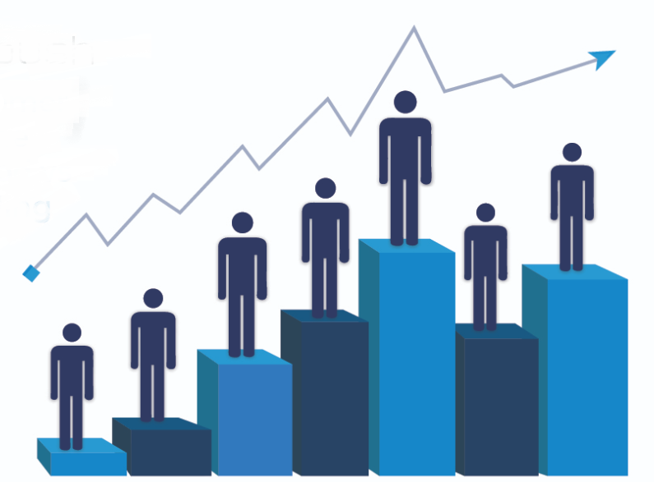
Customer LTV Analysis
Long term view

Slide 16

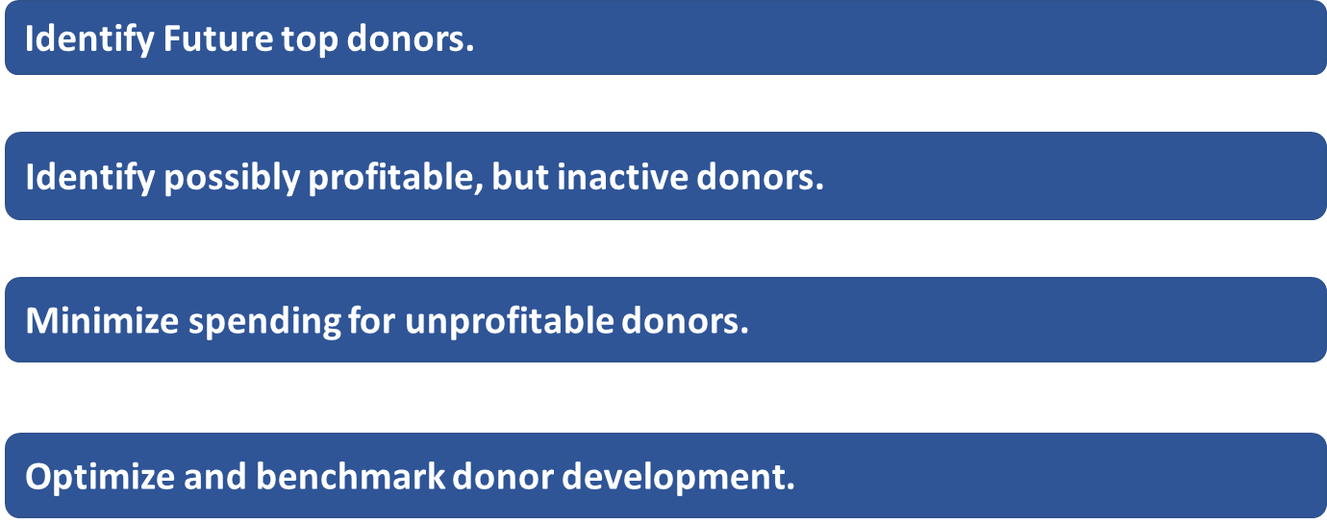



Relevance of Customer Lifetime Value (CLV)

Slide 17
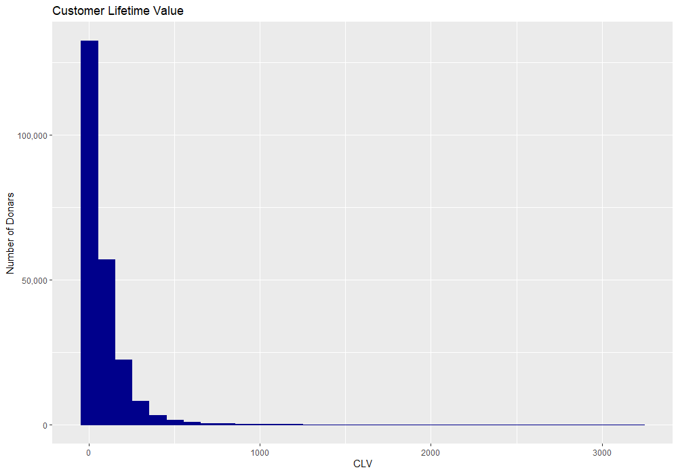
CLV - Identify the Top Donors
Customer Lifetime Value | Number of Donors
0-50 | 137721
50-100 | 35076
100-500 | 68301
500-1000 | 6858
1000-2000 | 1870
2000 & above | 617
Short term objective: Target the customers with CLV less than 500.
Long term objective: Target the customers with CLV more than 500.
The high-valued customers (2000 and above) get most of the communications and marketing efforts.

Slide 18
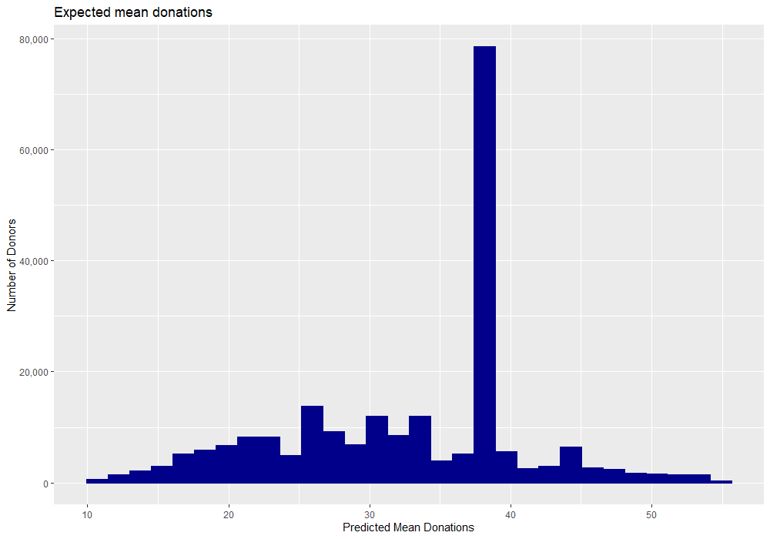
CLV - Identify the profitable donors and minimize spending for unprofitable donors
Estimated donations in the next year*
Percentiles | Mean Donations
25th percentile | 27.03068151
50% percentile | 38.09299515
75% percentile | 38.09299515
80% percentile | 39.13337579
90th percentile | 52.03635137
95th percentile | 71.86682069
Maximum Value | 28836.96513
This plot shows the distribution of the expected donations. About 80% of our donors have an estimated mean donation below $39. But some outliers can be a real game changer. The top 10% of the customers should be targeted for the all the campaigns whereas the bottom 50% can be targeted only when the campaign size is huge.
*This is estimated using Pareto NBD Model

Slide 19
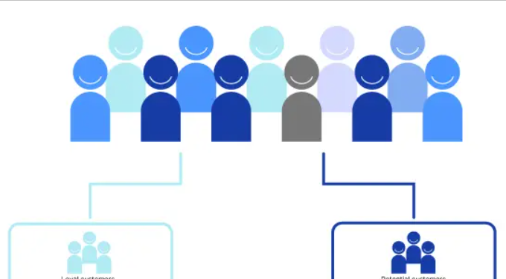
Segmentation
A combination between short term and long term view

Slide 20
Key points
01
Based on both long and short term focused analysis
k-mean segmentation using variables predicted by the donors life-time value model
Analysis of each cluster reaction to campaigns
02
Number of segments optimized for managerial use
The number of segments was picked (a priori) after different trials
The decision was taken based on the best identifiability of clusters and differentiation in reactions
03
4 Segments identified
Top Donors
Persuadables
Do Not Disturb
Lost Causes

Slide 21
Segments description

Slide 22
Reaction to campaigns by segments

Slide 23

Churn Model
Understand when to solicit donors

Slide 24
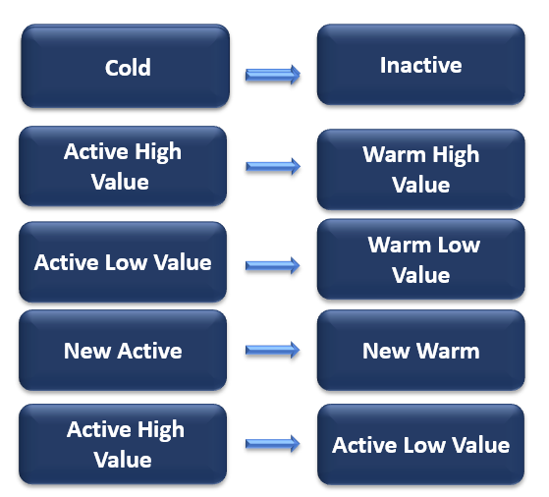
Identifying Churners*
Customers once active that are now/turning inactive .
The following segments indicates possible churning
Signalling deeper research into these segments to try to retain these donors before they churn.
*calculated monthly based on YoY activity

Slide 25
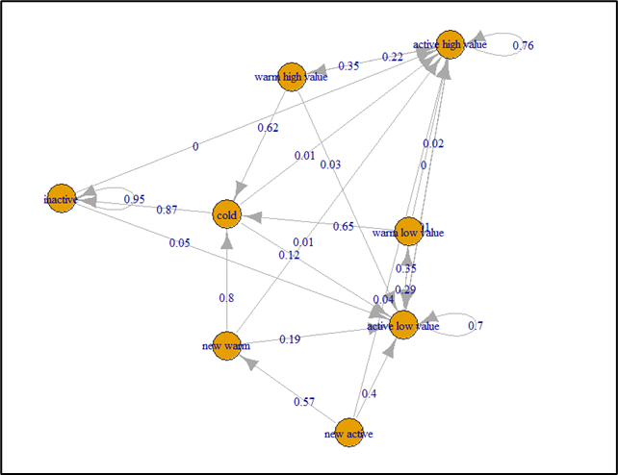
Transition graphs
This graph shows us the movement of customers from one segment to another.
The donors moving towards cold have high probability of becoming inactive -> churning.
The donors moving to inactive, could have possibly churned.
Consider donors moving from region of activity to region of inactivity. And identify WHY?

Slide 26
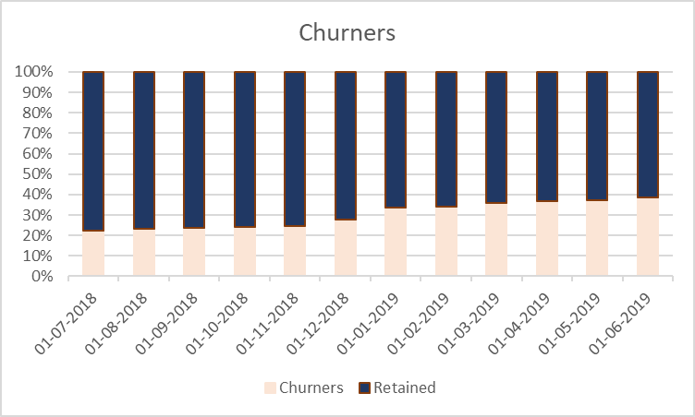
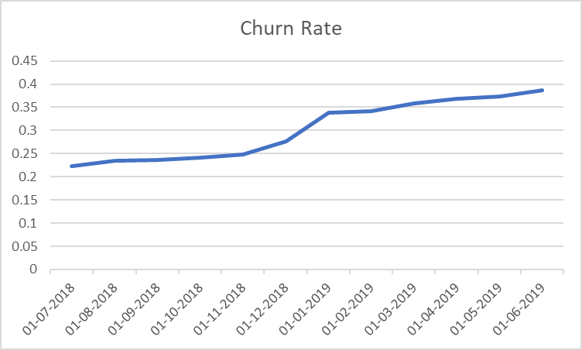
Monthly churn prediction
The churn rate varies between 22% to 38%. The predicted churn rate is basically giving us the indication of the donors who might churn

Slide 27
Analysing churn behaviour
just a one time donor
New Donor
donor has moved to our competitor
Churned Donor
Active Donor
We are doing good!
disinterested donor
Warm Donor
donor starts losing interest

Slide 28
Recommendations

Slide 29
Solicit each segment based on the churn model

Slide 30
Type of solicitation for each segment

Slide 31
Budget Planning

Slide 32
This is an estimation of the budget.

